Slide 1
Cortex-M3 Memory Systems

Slide 2
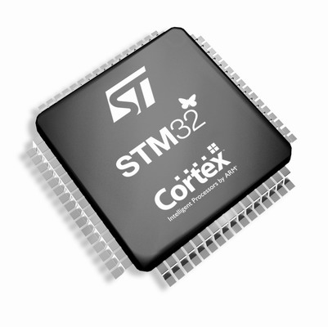
Chapter 5 in the reference book

Slide 3
8.4 Memory System
8.4.1 Memory System Features Overview
1. A predefined memory map that specifies which bus interface is to be used when a memory location is accessed.
2. Bit-band: This provides atomic operations to bit data in memory or peripherals, only supported in special memory regions
3. Supports unaligned transfers and exclusive accesses as well.
4. the Cortex-M3 supports both little endian and big endian memory configuration

Slide 4
8.4.2 Memory Maps
The Cortex-M3 processor has a fixed memory map.
Some of the memory locations are allocated for private peripherals such as debugging components.
1. Fetch Patch and BreakPoint Unit (FPB)
2. Data WatchPoint and Trace Unit (DWT)
3. Instrumentation Trace Macrocell (ITM)
4. Embedded Trace Macrocell (ETM)
5. Trace Port Interface Unit (TPIU)
6. ROM Table
The Cortex-M3 processor has a total of 4 GB of address space.

Slide 5
A Cortex-M3 Predefined Memory Map

Slide 6
SRAM:
0.5 GB. The SRAM memory range is for connecting internal SRAM.
On-chip peripherals:
0.5 GB, supports bit-band alias and is accessed via the system bus interface.
External RAM:
1 GB. Program execution is allowed.
External devices:
1 GB. Program execution is not allowed.
System-level components + internal private peripheral buses + external private peripheral bus + vendor-specific system peripherals:
0.5 GB.

Slide 7
Private peripheral bus:
1. AHB private peripheral bus, for Cortex-M3 internal AHB peripherals only.
2. APB private peripheral bus, for Cortex-M3 internal APB devices as well as external peripherals.
The System Control Space

Slide 8

8.4.3 Memory Access Attributes
The memory map also defines the memory attributes of accessing each memory block or device:
The default memory attribute settings can be overridden if MPU is present and the region is programmed differently from the default.
Bufferable
Cacheable
Sharable
Executable

Slide 9
Address Space Division and Attributes
Region | Address | For | Cacheable | Executable, buffered
Code memory region | 0x00000000–0x1FFFFFFF | Code and data as well | cacheable | Executable, write buffered
SRAM memory region | 0x20000000–0x3FFFFFFF | On-chip RAM | cacheable | Executable, write buffered
Peripheral region | 0x40000000–0x5FFFFFFF | Peripherals | Noncacheable | Nonexecutable
External RAM region | 0x60000000–0x7FFFFFFF | Either on-chip or off-chip memory | cacheable | Executable
External RAM region | 0x80000000–0x9FFFFFFF | Either on-chip or off-chip memory | cacheable | Executable
External devices | 0xA0000000–0xBFFFFFFF | External devices and/or shared memory | Noncacheable | Nonexecutable, nonbuffered
External devices | 0xC0000000–0xDFFFFFFF | External devices and/or shared memory | Noncacheable | Nonexecutable, nonbuffered
System region | 0xE0000000–0xFFFFFFFF | Private peripherals and Vendor-specific devices | Noncacheable | Nonexecutable, nonbuffered (buffered for vendor-specific memory)

Slide 10
8.4.4 Default Memory Access Permissions
The Cortex-M3 memory map has a default configuration for memory access permissions
Prevents user program from accessing system control memory spaces
The default memory access permission is used when either:
1. No MPU is present
2. MPU is present but disabled
Otherwise, the MPU will determine whether user accesses are allowed
When a user access is blocked, the fault exception takes place immediately.

Slide 11
Default Memory Access Permissions
Memory Region | Address | Access in User Program
Vendor specific | 0xE0100000–0xFFFFFFFF | Full access
ETM | 0xE0041000–0xE0041FFF | Blocked; user access results in bus fault
TPIU | 0xE0040000–0xE0040FFF | Blocked; user access results in bus fault
Internal PPB | 0xE000F000–0xE003FFFF | Blocked; user access results in bus fault
NVIC | 0xE000E000–0xE000EFFF | Blocked; user access results in bus fault
FPB | 0xE0002000–0xE0003FFF | Blocked; user access results in bus fault
DWT | 0xE0001000–0xE0001FFF | Blocked; user access results in bus fault
ITM | 0xE0000000–0xE0000FFF | Read allowed; write ignored except for stimulus ports with user access enabled
External Ram | 0x60000000–0x9FFFFFFF | Full access
Peripheral | 0x40000000–0x5FFFFFFF | Full access
SRAM | 0x20000000–0x3FFFFFFF | Full access
Code | 0x00000000–0x1FFFFFFF | Full access

Slide 12
8.4.5 Bit-Band Operations
Bit-band operation support allows a single load/store (read/write) operation to access a single data bit.
Bit-band regions:
1. The first 1 MB of the SRAM region
2. The first 1 MB of the peripheral region
They can be accessed via a separate memory region called the bit-band alias.

Slide 13
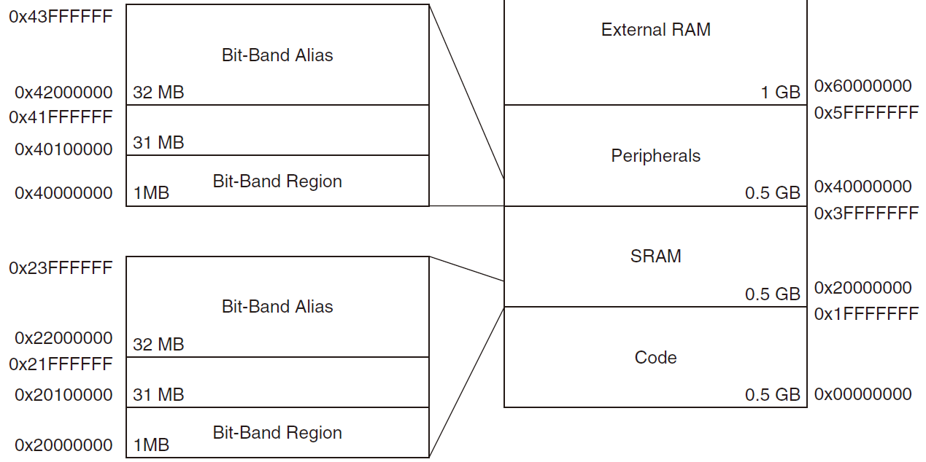
Bit-Band Region and Bit-Band Alias

Slide 14
Remapping of Bit-Band Addresses in SRAM Region
Remapping of Bit-Band Addresses in Peripheral Memory Region
Bit-Band Region | Aliased Equivalent
0x20000000 bit[0] | 0x22000000 bit[0]
0x20000000 bit[1] | 0x22000004 bit[0]
0x20000000 bit[2] | 0x22000008 bit[0]
… | …
0x20000000 bit[31] | 0x2200007C bit[0]
0x20000004 bit[0] | 0x22000080 bit[0]
… | …
0x20000004 bit[31] | 0x220000FC bit[0]
… | …
0x200FFFFC bit[31] | 0x23FFFFFC bit[0]
Bit-Band Region | Aliased Equivalent
0x40000000 bit[0] | 0x42000000 bit[0]
0x40000000 bit[1] | 0x42000004 bit[0]
0x40000000 bit[2] | 0x42000008 bit[0]
… | …
0x40000000 bit[31] | 0x4200007C bit[0]
0x40000004 bit[0] | 0x42000080 bit[0]
… | …
0x40000004 bit[31] | 0x420000FC bit[0]
… | …
0x400FFFFC bit[31] | 0x43FFFFFC bit[0]

Slide 15
Bit Accesses to Bit-Band Region Via the Bit-Band Alias

Slide 16
Write to Bit-Band Alias
To set bit 2 in word data in address 0x20000000:
Write:

Slide 17
The assembler sequence to
Write:
1. Without Bit-Band:
LDR R0, =0x20000000 ; Setup address
LDR R1, [R0] ; Read
ORR.W R1, #0x4 ; Modify bit
STR R1, [R0] ; Write back result
2. With Bit-Band:
LDR R0, =0x22000008 ; Setup address
MOV R1, #1 ; Setup data
STR R1, [R0] ; Write

Slide 18
Read from the Bit-Band Alias
Read:

Slide 19
The assembler sequence to read:
1. With Bit-Band:
LDR R0, =0x20000000 ; Setup address
LDR R1, [R0] ; Read
UBFX.W R1, R1, #2, #1 ; Extract bit[2]
2. With Bit-Band:
LDR R0, =0x22000008 ; Setup address
LDR R1, [R0] ; Read

Slide 20
For read operations, the word is read and the chosen bit location is shifted to the LSB of the read return data.
For write operations, the written bit data is shifted to the required bit position, and a READ-MODIFY-WRITE is performed.

Slide 21
Example:
1. Set address 0x20000000 to a value of 0x3355AACC.
2. Read address 0x22000008. This read access is remapped into read access to 0x20000000. The return value is 1 (bit[2] of 0x3355AACC).
3. Write 0x0 to 0x22000008.
4. Now read 0x20000000. That gives you a return value of 0x3355AAC8 (bit[2] =0).

Slide 22
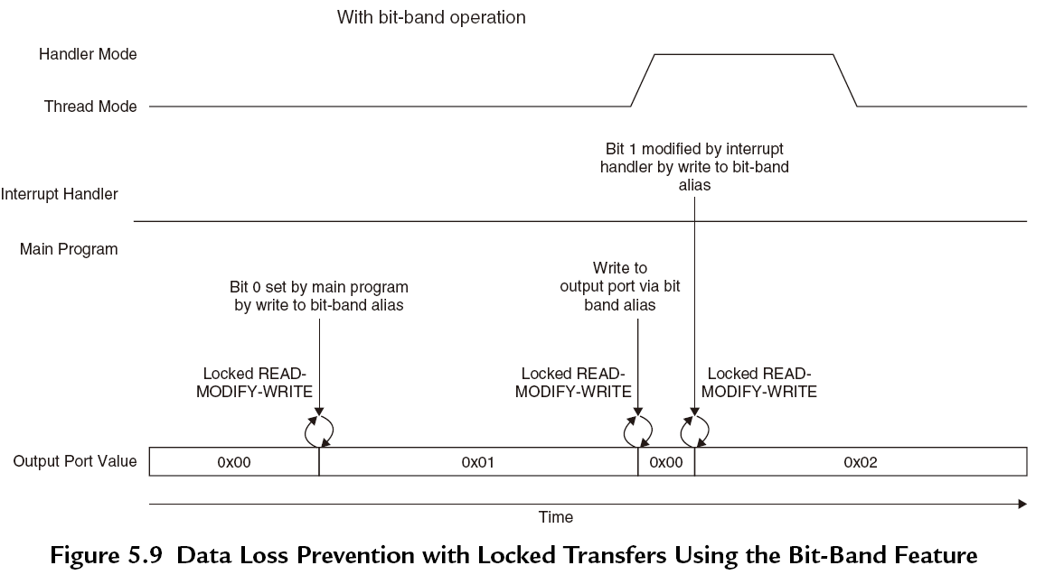
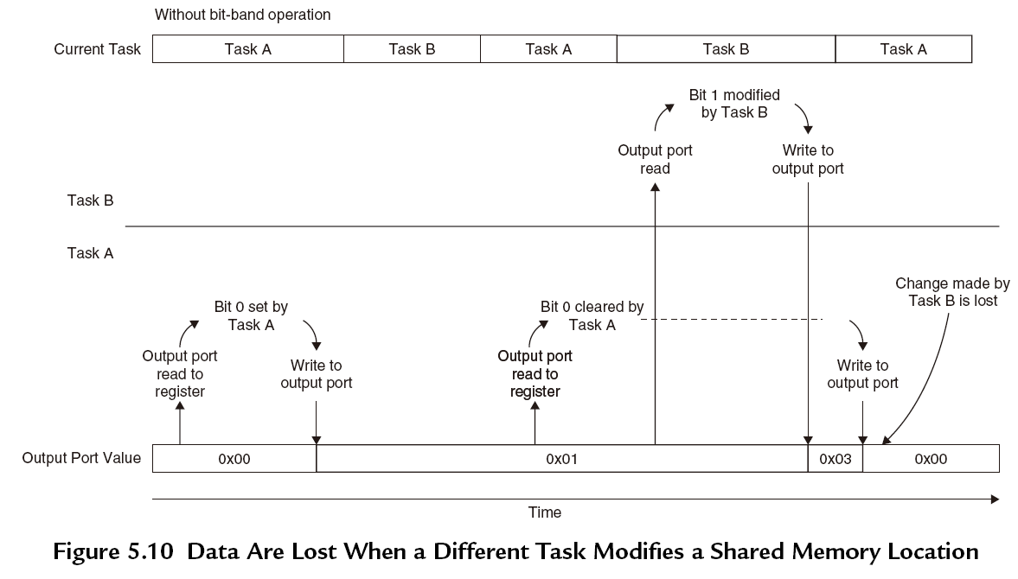
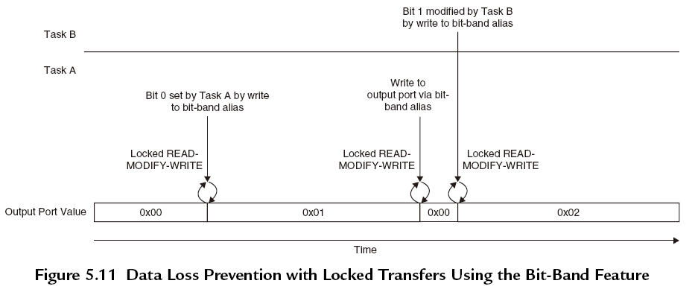
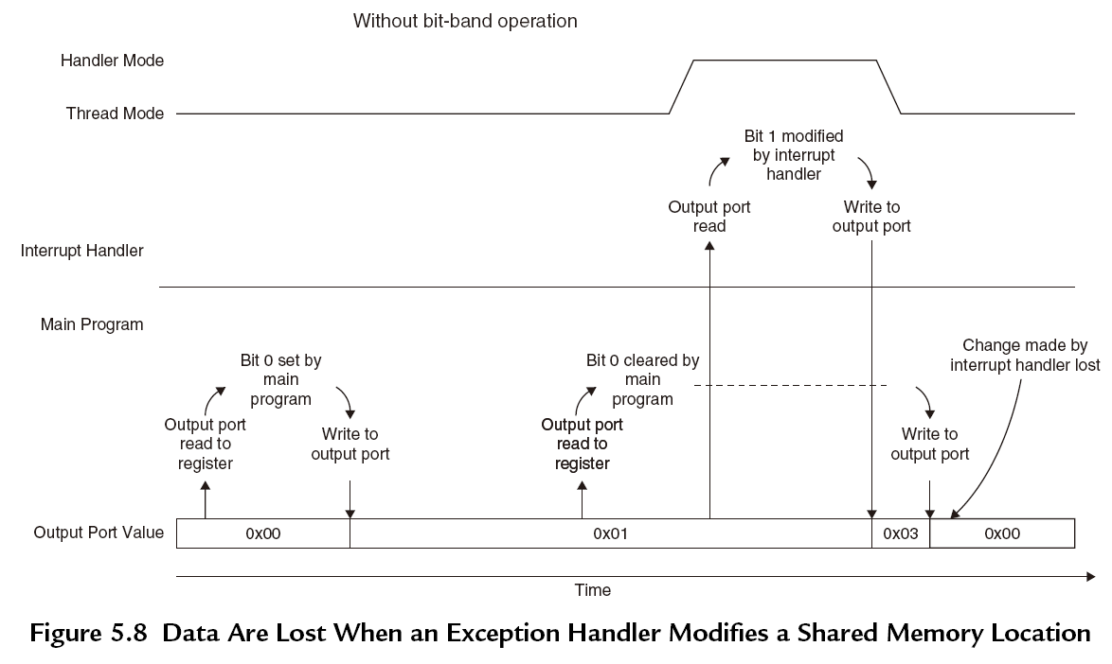
Advantages of using bit-band operations:
Faster bit operations with fewer instructions
Exclusive read/write operations (by hardware)
Store and handle Boolean data in the SRAM region (packed together and can be accessed separately)

Slide 23
8.4.6 Unaligned Transfers
The Cortex-M3 supports unaligned transfers on single accesses. Data memory accesses can be defined as aligned or unaligned.
1. Word size, the address is not a multiple of 4.
 | Byte 3 | Byte 2 | Byte 1 | Byte 0
Address N+4 |  |  |  | [31:24]
Address N | [23:16] | [15:8] | [7:0]
Unaligned Transfer Example 1
 | Byte 3 | Byte 2 | Byte 1 | Byte 0
Address N+4 |  |  | [31:24] | [23:16]
Address N | [15:8] | [7:0]
Unaligned Transfer Example 2
 | Byte 3 | Byte 2 | Byte 1 | Byte 0
Address N+4 |  | [31:24] | [23:16] | [15:8]
Address N | [7:0]
Unaligned Transfer Example 3

Slide 24
2. Half word size, and the address is not a multiple of 2.
 | Byte 3 | Byte 2 | Byte1 | Byte 0
Address N+4
Address N |  | [15:8] | [7:0]
Unaligned Transfer Example 4
 | Byte 3 | Byte 2 | Byte 1 | Byte 0
Address N+4 |  |  |  | [15:8]
Address N | [7:0]
Unaligned Transfer Example 5

Slide 25
There are a number of limitations:
1. Not supported in Load/Store multiple instructions.
2. Stack operations (PUSH/POP) must be aligned.
3. Exclusive accesses must be aligned.
4. Unaligned transfers are not supported in bit-band operations.
When unaligned transfers are used, they are actually converted into multiple aligned transfers by the processor’s bus interface unit
Transparent to application programmers.
It takes more clock cycles for a single data access

Slide 26

8.4.7 Exclusive Accesses(LDREX,STREX)
SWP instruction (swap) was used to check semaphore status in early ARM processors. But Cortex-M3 cannot support SWP any more.
1. What is semaphore?
Semaphores are commonly used for allocating shared resources to applications. When a resource is being used by one process, it is locked to that process and exclusive to others. A semaphore is the lock flag.
2. Why is exclusive access used instead of SWP instruction?
When a process or application want to use a resource, it needs to check whether the resource has been locked first.
In ARM V7 architecture, the read/write access can be carried out on separated buses. Therefore, the SWP instructions (requiring the read and write in a locked transfer sequence must be on the same bus) can no longer be used to make the memory access atomic.
Therefore, the locked transfers are replaced by exclusive accesses.

Slide 27
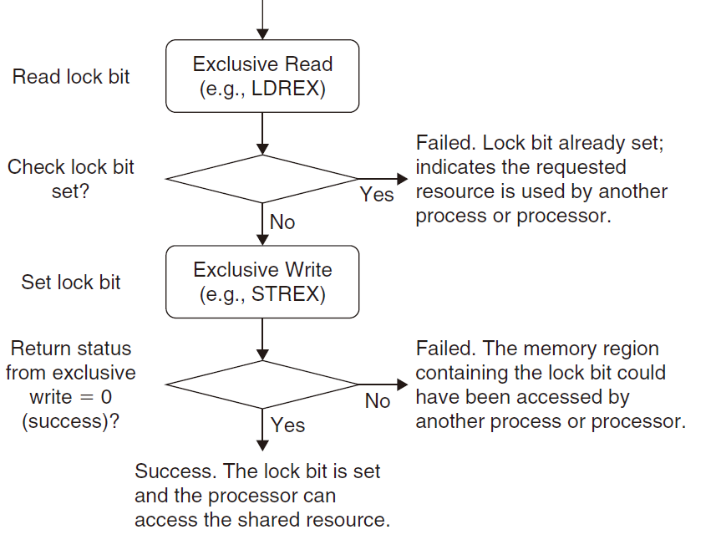
3. The difference between SWP instructions and exclusive access.
The concept of exclusive access operation is quite simple but different from SWP, which allows the possibility that the memory location for a semaphore could be accessed by multiple buses.

Slide 28
Exclusive access instructions include:
1. LDREX (word)
2. LDREXB (byte)
3. LDREXH (half word)
4. STREX (word)
5. STREXB (byte)
6. STREXH (half word)

Slide 29
8.4.8 Endian Mode
The Cortex-M3 supports both little endian(recommended) and big endian modes.
However, the supported memory type also depends on the design of the rest of the microcontroller (bus connections, memory controllers, peripherals, and so on).
Make sure that you check your microcontroller datasheets in detail before developing your software
The definition of big endian in the Cortex-M3 is different from the ARM7’s.
In the ARM7TDMI, the big endian scheme is called word-invariant big endian, whereas in the Cortex-M3, the big endian scheme is called byte-invariant big endian.

Slide 30
The Cortex-M3 (Byte-Invariant Big Endian): Data in memory
Address, Size | Bits 31-24 | Bits 23-16 | Bits 15-8 | Bits 7-0
0x1000, word | Data[7:0] | Data[15:8] | Data[23:16] | Data[31:24]
0x1000, half word | Data[7:0] | Data[15:8] | -- | --
0x1000, byte | Data[7:0]
0x1001, byte |  | Data[7:0]
0x1002, byte |  |  | Data[7:0]
0x1003, byte |  |  |  | Data[7:0]

Slide 31
The endian mode is set when the processor exits reset and it cannot be changed afterward.
Instruction fetches are always in little endian, as are data accesses in the configuration control memory space and the external PPB memory range.
The data can be easily converted between little endian and big endian using instructions REV/REVH.

